Slide 1
Apache Lucene

Slide 2
What Lucene does?
It is an Information Retrieval tool.
It performs operations like Indexing, Reverse Indexing, Analysis etc.
These operations make the documents searchable.

Slide 3
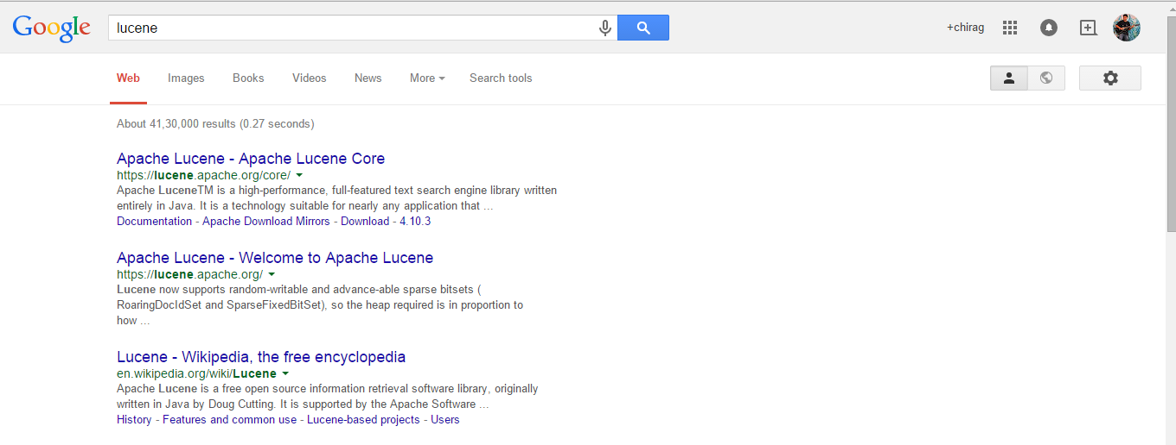

Slide 4
What Lucene does?
It is an Information Retrieval tool.
It performs operations like Indexing, Reverse Indexing, Analysis etc.
These operations make the documents searchable.

Slide 5
Inverted Index Example
Document 1 = “I like Cricket”
Document 2 = “I watch Cricket”
Document 3 = “I hate Cricket”
“I” = {1,2,3}
“like” = {1}
“watch” = {2}
“hate” = {3}
“Cricket” = {1,2,3}

Slide 6
Indexing in Lucene
Document
Analysis
Token
Indexing
Inverted Index
Term: “Cricket”
Position: 0
Offset: 0
Length: 7
Term: “Match”
Position: 1
Offset: 8
Length: 5
Tokenization
Cricket Match

Slide 7
12345

Slide 8
12345
“hello” or hello.

Slide 9
12345
“hello” or hello.
color or colors

Slide 10
12345
“hello” or hello.
color or colors
Hi or hi

Slide 11
12345
“hello” or hello.
color or colors
Hi or hi
the, of, and, if, on etc.

Slide 12
TF-IDF Model
TF : { Term frequency : total number of times the term appeared in a particular document}
IDF : { Inverse document frequency : total number of documents divided by number of documents containing the term}

Slide 13
TF-IDF Model
TF : { Term frequency : total number of times the term appeared in a particular document}
IDF : { Inverse document frequency : total number of documents divided by number of documents containing the term}
Score = tf * idf

Slide 14
Example
Imagine our dataset is made of 100 documents taken from a networking book.
Query = “mail transfer protocol”
idf for “protocol” ~ 1
idf for “mail” or “transfer” >1

Slide 15
Inverted Index Example
Document 1 = “I like Cricket”
Document 2 = “I watch Cricket”
Document 3 = “I hate Cricket”
“I” = {1,2,3}
“like” = {1}
“watch” = {2}
“hate” = {3}
“Cricket” = {1,2,3}

Slide 16
Example
Imagine our dataset is made of 100 documents taken from a networking book.
Query = “mail transfer protocol”
idf for “protocol” ~ 1
idf for “mail” or “transfer” >1

